Slide 1
Physical Design of IoT
P.Kalaivani
Assistant Professor/CSE
Kongu Engineering College

Slide 2
Things in IoT

Slide 3
Things in IoT usually refers to IoT devices which have unique identities and can perform
Remote Sensing
Actuating
Monitoring capabilities
Devices can exchange data with other connected devices and applications or collect data from other devices and process the data either locally or send the data to centralised servers or cloud based application for performing the data or perform local task within the IoT infrastructure

Slide 4
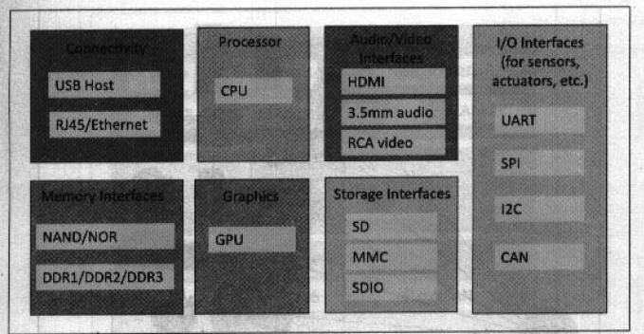
Block Diagram of an IoT Device
Several interfaces for connections to other devices
I/O interface –sensors
Internet connectivity interface
Memory and storage interface
Audio/Video interface
IoT devices can be connected to actuators that allow them to interact with other physical entities

Slide 5
List some of IoT devices

Slide 6
IoT Protocols

Slide 7
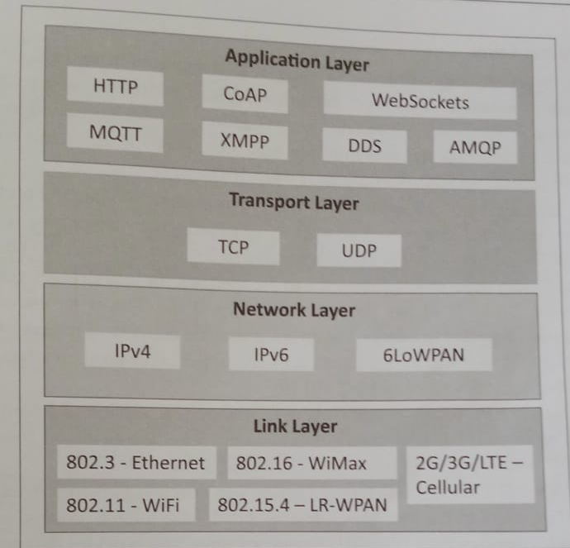
IoT Protocols Stack

Slide 8
IoT Protocols
Link Layer
Determines how the data is physically sent over the network’s physical layer or medium (Copper wire, coaxial cable, radio wave)
Scope – Limited to the local network connection to which host is attached.
Hosts on the same link exchange data packets over the link layer protocol
Determines how the packets are coded and signalled by the hardware device over the medium to which the host is attached.
802.3 – Ethernet
802.11 – WiFi
802.16 – WiMax
802.15.4 – LR-WPAN
2G/3G/4G – Mobile Communication

Slide 9
Link Layer Protocols
802.3 – Ethernet - Collection of wired Ethernet standards for the link layer
Example: 10BASE5 Ethernet – Coaxial cable as a shared medium
802.3i is a standard for 10BASE-T Ethernet over copper twisted-pair connections
802.3j is a standard for 10BASE-F Ethernet over fiber optic connections
802.3ae is a standard for 10Gbit/s Ethernet over fiber
The shared medium (broadcast) – carries communication for all the devices on the network
Data sent by one device can be received by all devices subject to propagation conditions and transceiver capabilities

Slide 10
Link Layer Protocols (contd.,)
802.11 – WiFi - collection of wireless local area network (WLAN) communication standards
Operational Frequency
802.11a – 5GHz band
802.11b – 2.4 GHz
802.11g – 2.4 GHz
802.11n – 2.4/5 GHz
802.11ac – 5GHz
802.11ad – 60 GHz
Data rate – 1 Mbps to 6.75 Gbps

Slide 11
Link Layer Protocols (contd.,)
802.16 – WiMax – collection of wireless broadband standards
Data rate – 1.5 Mbps to 1 Gbps
802.16m – data rate of 100 Mbps for mobile stations and 1Gbps for fixed stations
802.15.4 – LR-WPAN – collection of standards for low-rate wireless personal area networks (LR-WPAs)
Provides basis specification for high-level communication protocols such as ZigBee
Data rate – 40 Kbps to 250 Kbps
Provides low-cost and low-speed communication for power constrained devices

Slide 12
Link Layer Protocols (contd.,)
2G / 3G / 4G – Mobile Communication
2G – GSM & CDMA
3G – UMTS & CDMA200
4G – LTE
IoT devices based on these standards can communicate over cellular networks
Data rate – 9.6 Kbps (2G) to 100 Mbps (4G)

Slide 13
Network / Internet Layer
Responsible for sending IP datagrams from the source network to the destination network
Performs host addressing and routing
Datagram – contain source and destination address
Host identification – IP addressing scheme - IPv4 or IPv6
IPv4
32-bit address - address space 2³²
More devices connected to Internet – addresses got exhausted – succeeded by IPv6
IP – establish connections on packet network, but do not guarantee delivery of packets
Guaranteed delivery and data integrity – handled by TCP

Slide 14
Network / Internet Layer (contd.,)
IPv6 – 128-bit address
6LoWPAN – IPv6 over Low Power Wireless Personal Area Networks)
Brings IP protocol to low-power devices which have limited processing capability
Operates in 2.4 GHz
Data rate – 250 Kbps
6LoWPAN – works with 802.15.4 link layer protocol and defines compression mechanism for IPv6 datagrams over IEEE 802.15.4 based networks

Slide 15
Transport Layer
End-to-end message transfer capability independent of underlying network
Message transfer – set up connections – using handshakes (TCP) or without handshakes / acknowledgements (UDP)
Provides error control, segmentation, flow control and congestion control
Transmission Control Protocol (TCP)
Widely used by web browsers (HTTP, HTTPS) , e-mail (SMTP), file transfer(FTP)
TCP is connection oriented and stateful protocol
TCP ensures reliable transmission of packet in-order
Provides – error detection capability – duplicate packets can be discarded and lost packets are retransmitted
Flow control – rate at which the sender sends the data is not too high for the receiver to process
Congestion control – avoiding network congestion and congestion collapse

Slide 16
Transport Layer (contd.,)
User Datagram Protocol (UDP)
Connectionless protocol
Useful for time-sensitive applications – very small data units to exchange – not overhead of connection set up
UDP – transaction oriented and stateless protocol
Does not provide guaranteed delivery, ordering of messages and duplicate elimination

Slide 17
Application Layer
Application layer – how application interface with the lower layer protocols to send data over the network – process-to-process connections using ports
Application (files) – encoded by application layer protocol – encapsulated in the transport layer protocol – can be connection or transaction oriented communication over the network
Port numbers – application addressing (80 – HTTP, 22-SSH)
HTTP
CoAP
WebSocket
MQTT
XMPP
DDS
AMQP

Slide 18
Application Layer (contd.,)
HTTP – Hyper Text Transfer Protocol – foundation for World Wide Web (WWW)
Commands – GET, PUT, POST, DELETE, HEAD, TRACE, OPTIONS
Follows – Request – Response model – client sends requests to a server using HTTP commands
HTTP – stateless protocol – each HTTP request is independent of the other requests
HTTP client can be a browser or an application running on the client
HTTP protocol uses – Universal Resource Identifiers (URIs) to identify HTTP resources

Slide 19
Application Layer (contd.,)
CoAP – Constrained Application Protocol – application layer protocol for machine-to-machine application, constrained environments with constrained devices and constrained networks.
CoAP – web transfer protocol and uses a request-response model – runs on top of UDP
Uses client-server architecture – using connectionless datagrams
Can easily interface with HTTP
Supports methods – GET, PUT, POST and DELETE

Slide 20
Application Layer (contd.,)
WebSocket – allows full-duplex communication over single socket connection for sending message between client and server
It is based on TCP and allows streams of message to be sent back and forth between the client and server while keeping TCP connection open
Client – browser, mobile application, IoT devices

Slide 21
Application Layer (contd.,)
MQTT – Message Queue Telemetry Transport – light-weight messaging protocol based on publish- subscribe model
Uses client-server architecture – client(IoT devices) connect to the server(MQTT broker) and publishes message to topics on the server
The broker forwards the messages to the client subscribed to topics
MQTT – well suited for constrained environment – devices have limited processing and memory resources – low network bandwidth

Slide 22
Application Layer (contd.,)
XMPP – Extensible Messaging and Presence Protocol – real time communication – streaming XML data between network entities
Supports wide range of applications – messaging, presence, data syndication, gaming, multi-party chat and voice/video calls
Allows sending small chunks of XML data from one network entity to another in near real-time
It is a decentralized protocol and uses client-server architecture
Supports both client-to-server and server-to-server communication paths
In IoT context, XMPP allows real-time communication between IoT devices

Slide 23
Application Layer (contd.,)
DDS – Data Distribution Service – data centric middleware standard for device-to-device or M2M communication
Uses publish-subscribe model – publishers(devices that generate data) create topics to which subscribers(devices that want to consume data) can subscribe
Publisher – object responsible for data distribution
Subscriber – responsible for receiving published data
DDS provides quality of service (QoS) control and configurable reliability

Slide 24
Application Layer (contd.,)
AMQP – Advanced Message Queuing Protocol – open application layer protocol for business messaging
Supports both point-to-point and publisher/subscriber models, routing and queuing
AMQP brokers receive messages from publishers (devices or applications that generate data) and route them over connections to consumers (application that process data)
Publishers publish the messages to exchanges which then distribute message copies to queues
Messages are either delivered by the broker to the consumers which have subscribed to the queues or the consumers can pull the messages from the queues

